Slide 1
#6.1
Linear Regression and Correlation
Heatmaps
Boxplots, violin plots, swarm plots
Outputting figures

Slide 2
Linear regression
Model a scalar relationship between a dependent continuous variable and independent variable(s)
Attempts to fit a slope to the data to best describe it
Allows for correction of confounding variables

Slide 3
Using the same data from last class…
count_table <- read.table("~/Desktop/bioinformatics-bootcamp/class_6_1/sce_mct1_03hr_counts.txt", sep = '\t', header = TRUE, row.names = 1, check.names=F)

Slide 4
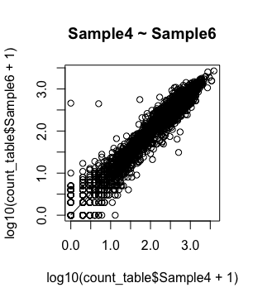
Linear modeling
> linearMod <- lm(
Sample4 ~ Sample6,
data=count_table)
> print(linearMod)
Coefficients:
(Intercept) Sample6
-0.7282 1.1097 <- a near linear
relationship

Slide 5
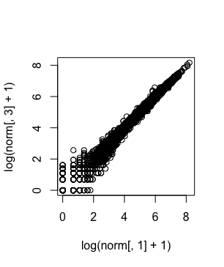
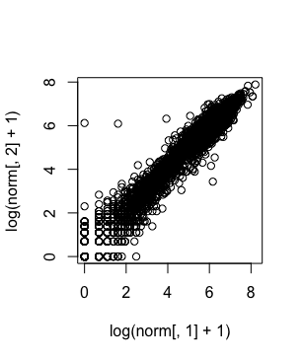
Correlation
A common measure in many biological contexts to compare replicates, etc.
Level of interdependence between two variables

Slide 6
Correlation examples in R
> cor(count_table["Sample4"], count_table["Sample6"])
Sample6
Sample4 0.943669
> cor(count_table["Sample4"], count_table["Sample10"])
Sample10
Sample4 0.9950528
Which samples are biological replicates?

Slide 7
Correlation examples in R
The cor() function by default uses a Pearson (R) correlation
Expects datasets to be normally distributed
By running cor(…, method=“spearman”), a Spearman (ρ) correlation coefficient will be calculated
Rank order correlation
Does not assume datasets are normally distributed (better for RNA-seq)
Coefficients are directional (negative or positive correlation)
The Coefficient of Determination (R²) measures the proportion of the variance in the dependent variable that is predictable from the independent variable

Slide 8
Correlation coefficients
The meaning of a correlation coefficient will vary field to field
Examples:
Biological replicates: > 0.99 indicate correlation
Human biological samples: something over 0.60 might be a correlation
Psychology: something over 0.20 might show a correlation

Slide 9
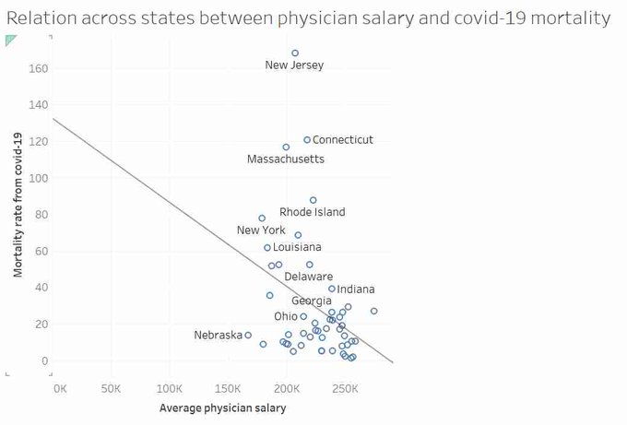
What isn’t correlation?
An example of why fitting a line can be misleading
The math will try to fit a line as best it can, but it’s always important to look at your scatterplot before fitting a line and see if you can naturally see a trend
My recommendation: Use a scatterplot with no line, provide correlation coefficient

Slide 10
Heatmaps
Look at broad patterns across several variables between samples
Use sample to sample normalized data (as appropriate)
Use z-scored gene values

Slide 11
Why do we use Z-scores?

Slide 12
Why do we use Z-scores?

Slide 13
Plotting a heatmap in R
> library(tweeDEseq)
> norm <- normalizeCounts(count_table, method="TMM")
> top_data = norm[1000:1030,]
> library(pheatmap) #download if not installed
> pheatmap(as.matrix(top_data), scale = c("row"), cluster_cols=FALSE)

Slide 14
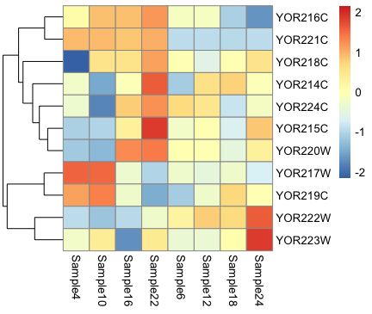
<- this is our deleted gene

Slide 15
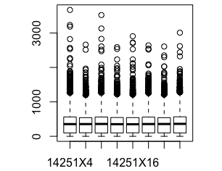
Boxplots
Hide data
> boxplot(norm)

Slide 16
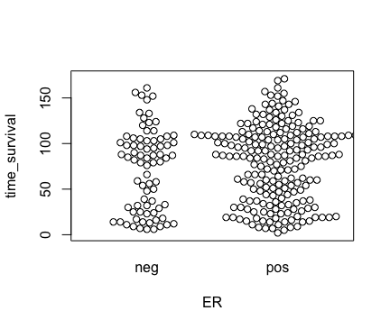
Beeswarm plot
Similar in concept to a boxplot, but more transparent
> library(beeswarm)
> data(breast)
> beeswarm(time_survival ~ ER, data = breast)

Slide 17
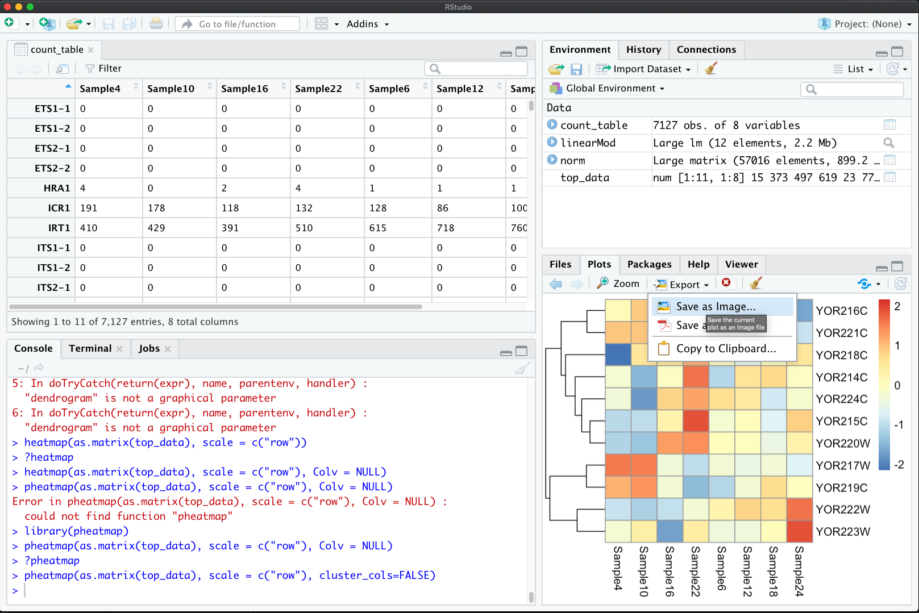
Outputting a figure

Slide 18
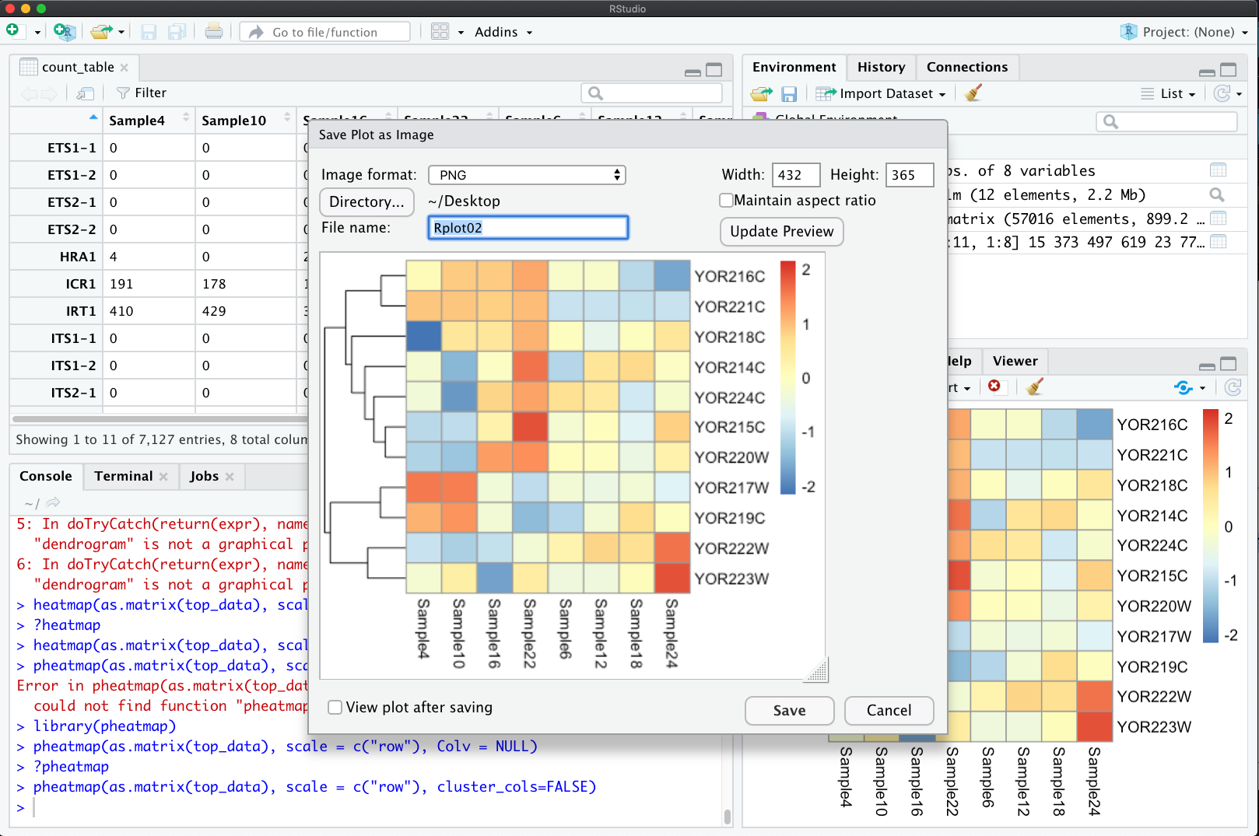
Outputting a figure

